Slide 1
Logistic Regression
Jurafsky and Martin Chapter 5

Slide 2
Notes:
The skip-gram model tries to shift embeddings so the target embedding (here for apricot) are closer to (have a higher dot product with) context embeddings for nearby words (here jam) and further from (have a lower dot product with) context embeddings for words that don’t occur nearby (here aardvark).
Note that the skip-gram model thus actually learns two separate embeddings for each word w: the target embedding t and the context embedding c. These embeddings are stored in two matrices, the target matrix T and the context matrix C. So each row i of the target matrix T is the 1 × d vector embedding ti for word i in the vocabulary V , and each column i of the context matrix C is a d × 1 vector embedding ci for word i in V . This figure shows an intuition of the learning task for the embeddings encoded in these two matrices.

Slide 3
Recap: How to learn word2vec (skip-gram) embeddings
Start with V random 300-dimensional vectors as initial embeddings
Use logistic regression to
Take a corpus and take pairs of words that co-occur as positive examples
Take pairs of words that don't co-occur as negative examples
Train the classifier to distinguish these by slowly adjusting all the embeddings to improve the classifier performance
Throw away the classifier code and keep the embeddings.
Notes:
Logistic regression is covered in Chapter 5 of the textbook

Slide 4
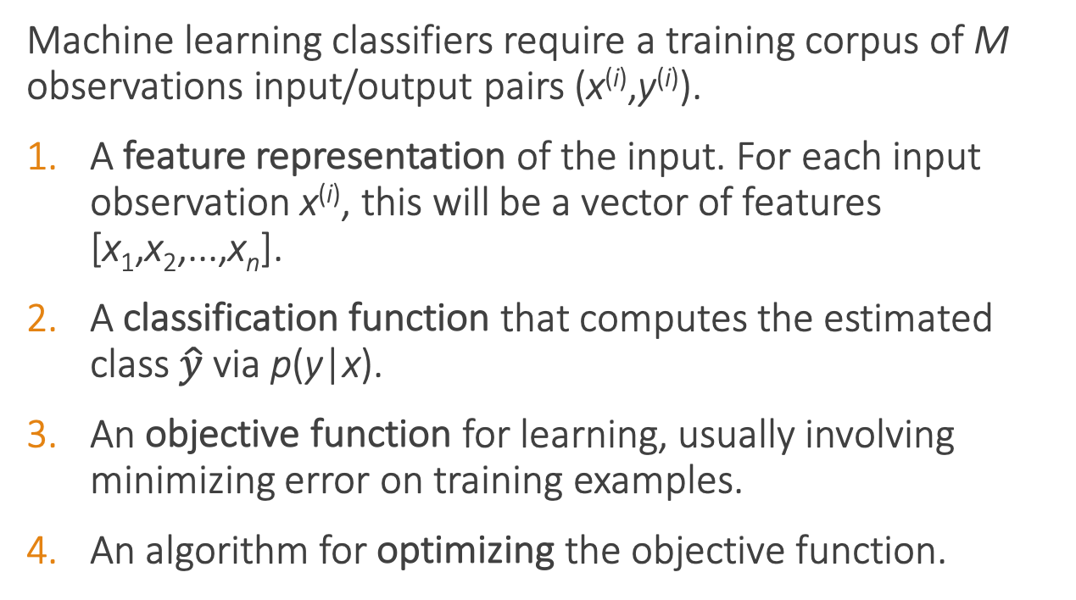
Classifier components
Machine learning classifiers require a training corpus of M observations input/output pairs (x^{(i)},y^{(i)}).
A feature representation of the input. For each input observation x^{(i)}, this will be a vector of features [x₁,x₂,...,x_{n}].
A classification function that computes the estimated class $\hat{y}$via p(y|x).
An objective function for learning, usually involving minimizing error on training examples.
An algorithm for optimizing the objective function.

Slide 5
Sentiment classifier
Input: "Spiraling away from narrative control as its first three episodes unreel, this series, about a post-apocalyptic future in which nearly everyone is blind, wastes the time of Jason Momoa and Alfre Woodard, among others, on a story that starts from a position of fun, giddy strangeness and drags itself forward at a lugubrious pace."
Output: positive or negative

Slide 6
Sentiment classifier
For sentiment classification, consider an input observation x, represented by a vector of features [x₁,x₂,...,x_{n}]. The classifier output y can be 1 (positive sentiment) or 0 (negative sentiment). We want to estimate P(y = 1|x).
Logistic regression solves this task by learning, from a training set, a vector of weights and a bias term.
We can also write this as a dot product:
Notes:
The weight wi represents how important that input feature is to the classification decision, and can be positive (meaning the feature is associated with the class) or negative (meaning the feature is not associated with the class). Thus we might expect in a sentiment task the word awesome to have a high positive weight, and abysmal to have a very negative weight. The bias term, also called the intercept, is another real number that’s added to the weighted inputs.
But note that nothing forces z to be a legal probability, that is, to lie between 0 and 1. In fact, since weights are real-valued, the output might even be negative; z ranges from −∞ to ∞.

Slide 7
Sigmoid function
Notes:
But note that nothing forces z to be a legal probability, that is, to lie between 0 and 1. In fact, since weights are real-valued, the output might even be negative; z ranges from −∞ to ∞.
To create a probability, we’ll pass z through the sigmoid function, σ(z). The sigmoid function (named because it looks like an s) is also called the logistic func- tion, and gives logistic regression its name.

Slide 8
Probabilities

Slide 9
Decision boundary
Now we have an algorithm that given an instance x computes the probability P(y = 1|x). How do we make a decision?
For a test instance x, we say yes if the probability P(y = 1|x) is more than .5, and no otherwise. We call .5 the decision boundary
Notes:
Now we have an algorithm that given an instance x computes the probability P(y = 1|x). How do we make a decision? For a test instance x, we say yes if the probability P(y = 1|x) is more than .5, and no otherwise. We call .5 the decision boundary

Slide 10
Extracting Features
It's hokey. There are virtually no surprises , and the writing is second-rate . So why was it so enjoyable? For one thing , the cast is great . Another nice touch is the music . I was overcome with the urge to get off the couch and start dancing . It sucked me in , and it'll do the same to you .
Var | Definition | Value
x₁ | Count of positive lexicon words
x₂ | Count of negative lexicon words
x₃ | Does no appear? (binary feature)
x₄ | Number of 1st and 2nd person pronouns
x₅ | Does ! appear? (binary feature)
x₆ | Log of the word count for the document

Slide 11
Extracting Features
It's hokey. There are virtually no surprises , and the writing is second-rate . So why was it so enjoyable? For one thing , the cast is great . Another nice touch is the music . I was overcome with the urge to get off the couch and start dancing . It sucked me in , and it'll do the same to you .
Var | Definition | Value
x₁ | Count of positive lexicon words | 3
x₂ | Count of negative lexicon words
x₃ | Does no appear? (binary feature)
x₄ | Number of 1st and 2nd person pronouns
x₅ | Does ! appear? (binary feature)
x₆ | Log of the word count for the document

Slide 12
Extracting Features
It's hokey. There are virtually no surprises , and the writing is second-rate . So why was it so enjoyable? For one thing , the cast is great . Another nice touch is the music . I was overcome with the urge to get off the couch and start dancing . It sucked me in , and it'll do the same to you .
Var | Definition | Value
x₁ | Count of positive lexicon words | 3
x₂ | Count of negative lexicon words | 2
x₃ | Does no appear? (binary feature)
x₄ | Number of 1st and 2nd person pronouns
x₅ | Does ! appear? (binary feature)
x₆ | Log of the word count for the document

Slide 13
Extracting Features
It's hokey. There are virtually no surprises , and the writing is second-rate . So why was it so enjoyable? For one thing , the cast is great . Another nice touch is the music . I was overcome with the urge to get off the couch and start dancing . It sucked me in , and it'll do the same to you .
Var | Definition | Value
x₁ | Count of positive lexicon words | 3
x₂ | Count of negative lexicon words | 2
x₃ | Does no appear? (binary feature) | 1
x₄ | Number of 1st and 2nd person pronouns
x₅ | Does ! appear? (binary feature)
x₆ | Log of the word count for the document

Slide 14
Extracting Features
It's hokey. There are virtually no surprises , and the writing is second-rate . So why was it so enjoyable? For one thing , the cast is great . Another nice touch is the music . I was overcome with the urge to get off the couch and start dancing . It sucked me in , and it'll do the same to you .
Var | Definition | Value
x₁ | Count of positive lexicon words | 3
x₂ | Count of negative lexicon words | 2
x₃ | Does no appear? (binary feature) | 1
x₄ | Number of 1st and 2nd person pronouns | 3
x₅ | Does ! appear? (binary feature)
x₆ | Log of the word count for the document

Slide 15
Extracting Features
It's hokey. There are virtually no surprises , and the writing is second-rate . So why was it so enjoyable? For one thing , the cast is great . Another nice touch is the music . I was overcome with the urge to get off the couch and start dancing . It sucked me in , and it'll do the same to you .
Word count = 64, ln(64) = 4.15
Var | Definition | Value
x₁ | Count of positive lexicon words | 3
x₂ | Count of negative lexicon words | 2
x₃ | Does no appear? (binary feature) | 1
x₄ | Number of 1st and 2nd person pronouns | 3
x₅ | Does ! appear? (binary feature) | 0
x₆ | Log of the word count for the document | 4.15

Slide 16
Var | Definition | Value | Weight | Product
x₁ | Count of positive lexicon words | 3 | 2.5
x₂ | Count of negative lexicon words | 2 | -5.0
x₃ | Does no appear? (binary feature) | 1 | -1.2
x₄ | Num 1st and 2nd person pronouns | 3 | 0.5
x₅ | Does ! appear? (binary feature) | 0 | 2.0
x₆ | Log of the word count for the doc | 4.15 | 0.7
b | bias | 1 | 0.1

Slide 17
Computing Z
Var | Definition | Value | Weight | Product
x₁ | Count of positive lexicon words | 3 | 2.5 | 7.5
x₂ | Count of negative lexicon words | 2 | -5.0 | -10
x₃ | Does no appear? (binary feature) | 1 | -1.2 | -1.2
x₄ | Num 1st and 2nd person pronouns | 3 | 0.5 | 1.5
x₅ | Does ! appear? (binary feature) | 0 | 2.0 | 0
x₆ | Log of the word count for the doc | 4.15 | 0.7 | 2.905
b | bias | 1 | 0.1 | .1
Z=0.805

Slide 18
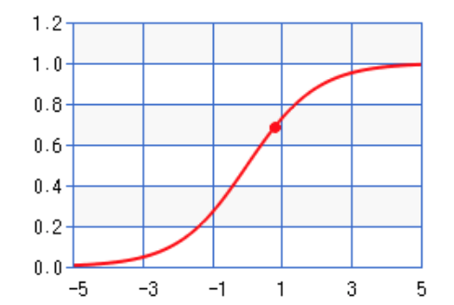
Sigmoid(Z)
Var | Definition | Value | Weight | Product
x₁ | Count of positive lexicon words | 3 | 2.5 | 7.5
x₂ | Count of negative lexicon words | 2 | -5.0 | -10
x₃ | Does no appear? (binary feature) | 1 | -1.2 | -1.2
x₄ | Num 1st and 2nd person pronouns | 3 | 0.5 | 1.5
x₅ | Does ! appear? (binary feature) | 0 | 2.0 | 0
x₆ | Log of the word count for the doc | 4.15 | 0.7 | 2.905
b | bias | 1 | 0.1 | .1
σ(0.805)
= 0.69
Notes:
So the probability that this is a positive review = 69%. The probability that it’s a negative review is 31%

Slide 19
Learning in logistic regression
How do we get the weights of the model? We learn the parameters (weights + bias) via learning. This requires 2 components:
An objective function or loss function that tells us distance between the system output and the gold output. We will use cross-entropy loss.
An algorithm for optimizing the objective function. We will use stochastic gradient descent to minimize the loss function.

Slide 20
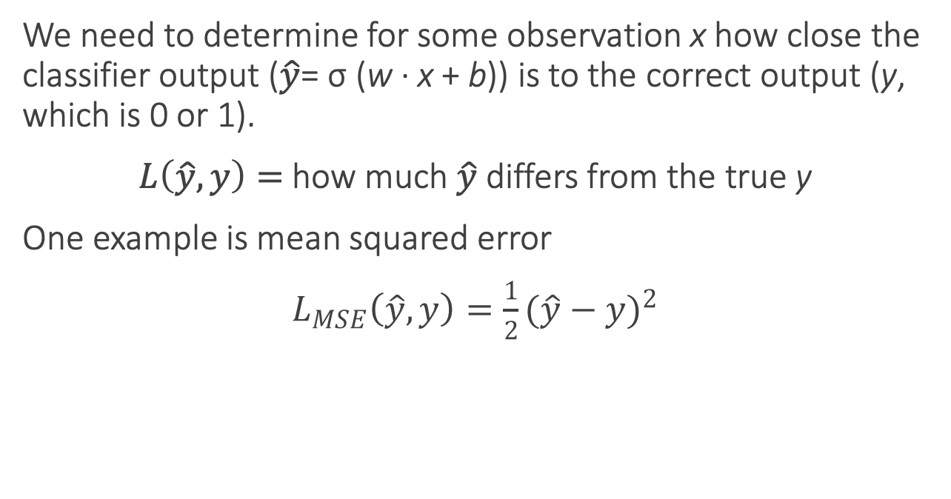
Loss functions
We need to determine for some observation x how close the classifier output ($\hat{y}$= σ (w · x + b)) is to the correct output (y, which is 0 or 1).
$L\left(\hat{y}, y\right)=$how much $\hat{y}$ differs from the true y
One example is mean squared error
$L_{MSE}\left(\hat{y}, y\right)=\frac{1}{2}{(\hat{y}−y)}^{2}$
Notes:
It turns out that this MSE loss, which is very useful for some algorithms like linear regression, becomes harder to optimize (technically, non-convex), when it’s applied to probabilistic classification.
https://towardsdatascience.com/why-not-mse-as-a-loss-function-for-logistic-regression-589816b5e03c

Slide 21
Loss functions for probabilistic classification
We use a loss function that prefers the correct class labels of the training example to be more likely.
Conditional maximum likelihood estimation: Choose parameters w, b that maximize the (log) probabilities of the true labels in the training data.
The resulting loss function is the negative log likelihood loss, more commonly called the cross entropy loss.

Slide 22
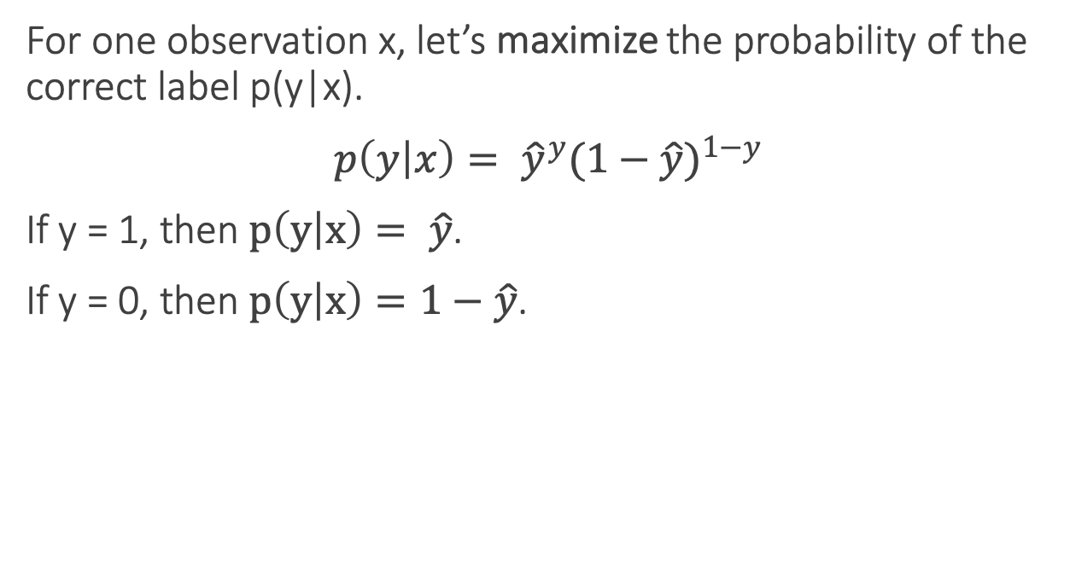
Loss functions for probabilistic classification
For one observation x, let’s maximize the probability of the correct label p(y|x).
$p\left(y | x\right)= {\hat{y}}^{y}{(1−\hat{y})}^{1−y}$
If y = 1, then $p\left(y | x\right)= \hat{y}$.
If y = 0, then $p\left(y | x\right)=1−\hat{y}$.

Slide 23
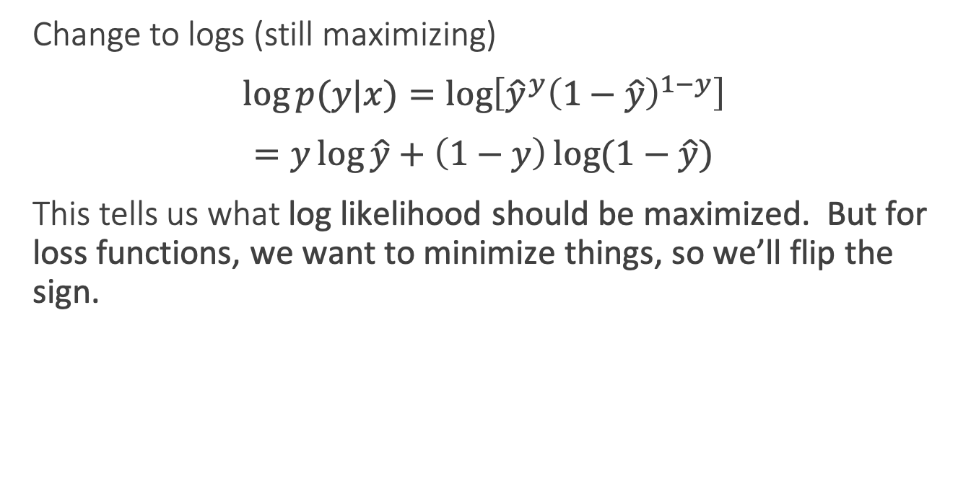
Loss functions for probabilistic classification
Change to logs (still maximizing)
$\log{p(y|x)}=\log\left[{\hat{y}}^{y}{\left(1−\hat{y}\right)}^{1−y}\right]$
$=y\log{\hat{y}}+\left(1−y\right)\log{(1−\hat{y})}$
This tells us what log likelihood should be maximized. But for loss functions, we want to minimize things, so we’ll flip the sign.

Slide 24
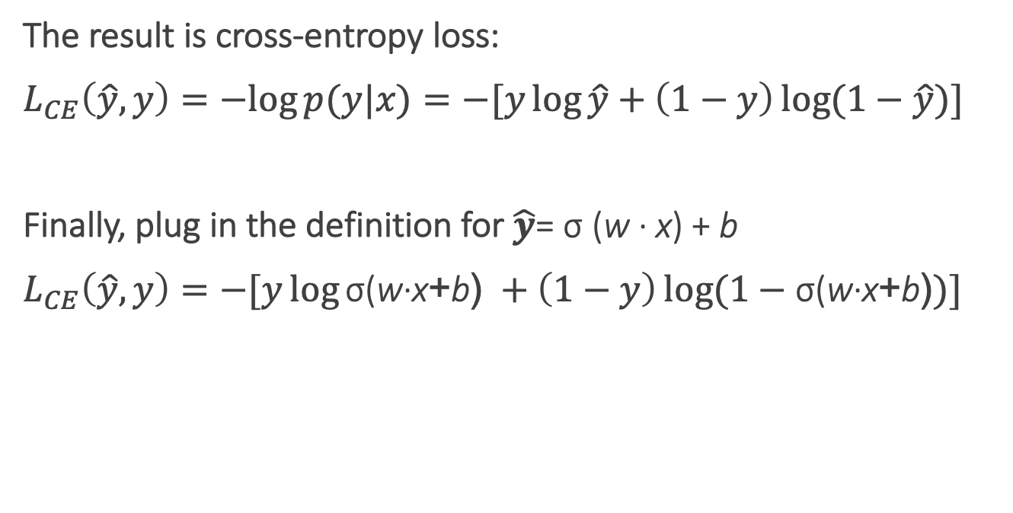
Cross-entropy loss
The result is cross-entropy loss:
$L_{CE}\left(\hat{y}, y\right)=−log{p(y|x)}=−[y\log{\hat{y}}+\left(1−y\right)\log{(1−\hat{y})]}$
Finally, plug in the definition for $\hat{y}$= σ (w · x) + b
$L_{CE}\left(\hat{y}, y\right)=−[y\log{\text{σ}\text{(}\text{w}\text{·}\text{x}\text{+}\text{b}\text{)} }+\left(1−y\right)\log{(1−\text{σ}\text{(}\text{w}\text{·}\text{x}\text{+}\text{b}\text{)})]}$
Notes:
In information theory, the cross entropy between two probability distributions p and q over the same underlying set of events measures the average number of bits needed to identify an event drawn from the set, if a coding scheme is used that is optimized for an "artificial" probability distribution q, rather than the "true" distribution p.
Information theoryEntropy
Differential entropy
Conditional entropy
Joint entropy
Mutual information
Conditional mutual information
Relative entropy
Entropy rate
Asymptotic equipartition property
Rate–distortion theory
Shannon's source coding theorem
Channel capacity
Noisy-channel coding theorem
Shannon–Hartley theorem
v

Slide 25
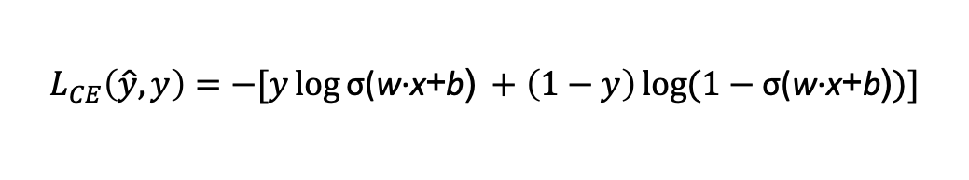
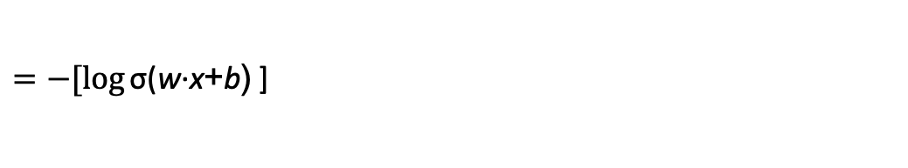

Cross-entropy loss
Why does minimizing this negative log probability do what we want? We want the loss to be smaller if the model’s estimate is close to correct, and we want the loss to be bigger if it is confused.
It's hokey. There are virtually no surprises , and the writing is second-rate . So why was it so enjoyable? For one thing , the cast is great . Another nice touch is the music . I was overcome with the urge to get off the couch and start dancing . It sucked me in , and it'll do the same to you .
P(sentiment=1|It’s hokey...) = 0.69. Let’s say y=1.
$$L_{CE}\left(\hat{y}, y\right)=−[y\log{\text{σ}\text{(}\text{w}\text{·}\text{x}\text{+}\text{b}\text{)} }+\left(1−y\right)\log{(1−\text{σ}\text{(}\text{w}\text{·}\text{x}\text{+}\text{b}\text{)})]}$$
$=−[\log{\text{σ}\text{(}\text{w}\text{·}\text{x}\text{+}\text{b}\text{)} }$]
$$=−\log{\text{(}\text{0.69}\text{)}=0.37}$$
Notes:
This loss function also ensures that as probability of the correct answer is maximized, the probability of the incorrect answer is minimized; since the two sum to one, any increase in the probability of the correct answer is coming at the expense of the incorrect answer.

Slide 26
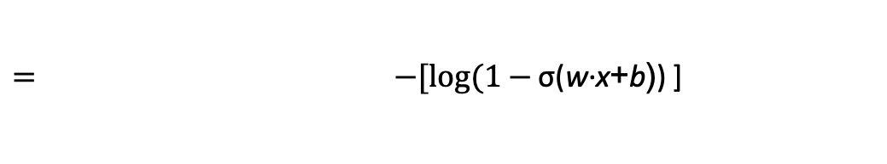
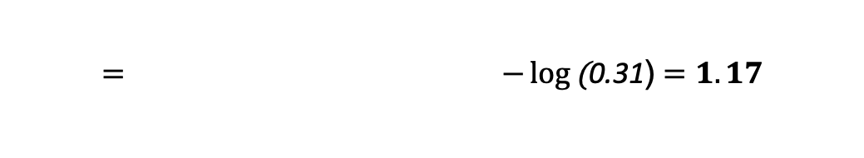
Cross-entropy loss
Why does minimizing this negative log probability do what we want? We want the loss to be smaller if the model’s estimate is close to correct, and we want the loss to be bigger if it is confused.
It's hokey. There are virtually no surprises , and the writing is second-rate . So why was it so enjoyable? For one thing , the cast is great . Another nice touch is the music . I was overcome with the urge to get off the couch and start dancing . It sucked me in , and it'll do the same to you .
P(sentiment=1|It’s hokey...) = 0.69. Let’s pretend y=0.
$$L_{CE}\left(\hat{y}, y\right)=−[y\log{\text{σ}\text{(}\text{w}\text{·}\text{x}\text{+}\text{b}\text{)} }+\left(1−y\right)\log{(1−\text{σ}\text{(}\text{w}\text{·}\text{x}\text{+}\text{b}\text{)})]}$$
$= −[log(1−{\text{σ}\text{(}\text{w}\text{·}\text{x}\text{+}\text{b}\text{)}\text{)} }$]
$$= −\log{\text{(}\text{0.31}\text{)}=1.17}$$
Notes:
This loss function also ensures that as probability of the correct answer is maximized, the probability of the incorrect answer is minimized; since the two sum to one, any increase in the probability of the correct answer is coming at the expense of the incorrect answer.

Slide 27
Loss on all training examples

Slide 28
Average Loss
This is what we want to minimize!!

Slide 29

Finding good parameters
We use gradient descent to find good settings for our weights and bias by minimizing the loss function.
Gradient descent is a method that finds a minimum of a function by figuring out in which direction (in the space of the parameters θ) the function’s slope is rising the most steeply, and moving in the opposite direction.
Notes:
Our goal with gradient descent is to find the optimal weights: minimize the loss function we’ve defined for the model. In Eq. 5.16 below, we’ll explicitly represent the fact that the loss function L is parameterized by the weights, which we’ll refer to in machine learning in general as θ (in the case of logistic regression θ = w, b)

Slide 30
Gradient descent
Notes:
The intuition is that if you are hiking in a canyon and trying to descend most quickly down to the river at the bottom, you might look around yourself 360 degrees, find the direction where the ground is sloping the steepest, and walk downhill in that direction.

Slide 31
Global v. Local Minimums
For logistic regression, this loss function is conveniently convex.
A convex function has just one minimum, so there are no local minima to get stuck in.
So gradient descent starting from any point is guaranteed to find the minimum.

Slide 32
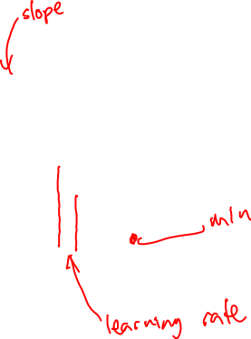
Iteratively find minimum
Notes:
The gradient descent algorithm answers this question by finding the gradient of the loss function at the current point and moving in the opposite direction. The gradient of a function of many variables is a vector pointing in the direction the greatest increase in a function. The gradient is a multi-variable generalization of the slope, so for a function of one variable like the one in Fig. 5.3, we can informally think of the gradient as the slope. The dotted line in Fig. 5.3 shows the slope of this hypothetical loss function at point w = w1. You can see that the slope of this dotted line is negative. Thus to find the minimum, gradient descent tells us to go in the opposite direction: moving w in a positive direction.
The first step in iteratively finding the minimum of this loss function, by moving w in the reverse direction from the slope of the function. Since the slope is negative, we need to move w in a positive direction, to the right. Here superscripts are used for learning steps, so w1 means the initial value of w (which is 0), w2 at the second step, and so on.

Slide 33
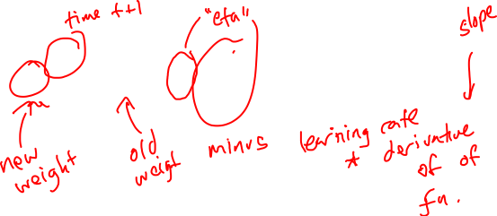
How much should we update the parameter by?
The magnitude of the amount to move in gradient descent is the value of the slope weighted by a learning rate η.
A higher/faster learning rate means that we should move w more on each step.
Notes:
η = eta. Is the learning rate
The change we make in our parameter is the
learning rate times the gradient (or the slope, in our single-variable example)
In each dimension wi, we express the slope as a partial derivative ∂ of the loss ∂wi
function.

Slide 34
Many diensions
Notes:
Now let’s extend the intuition from a function of one scalar variable w to many variables, because we don’t just want to move left or right, we want to know where in the N-dimensional space (of the N parameters that make up θ ) we should move. The gradient is just such a vector; it expresses the directional components of the sharpest slope along each of those N dimensions. If we’re just imagining two weight dimension (say for one weight w and one bias b), the gradient might be a vector with two orthogonal components, each of which tells us how much the ground slopes in the w dimension and in the b dimension.
In an actual logistic regression, the parameter vector w is much longer than 1 or 2, since the input feature vector x can be quite long, and we need a weight wi for each xi For each dimension/variable wi in w (plus the bias b), the gradient will have a component that tells us the slope with respect to that variable. Essentially we’re asking: “How much would a small change in that variable wi influence the total loss function L?”

Slide 35
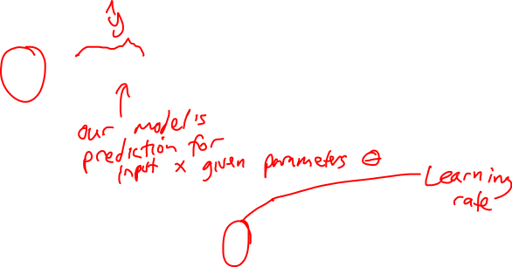
Updating each dimension w_{i}
The final equation for updating θ based on the gradient is
Notes:
In an actual logistic regression, the parameter vector w is much longer than 1 or 2, since the input feature vector x can be quite long, and we need a weight wi for each xi For each dimension/variable wi in w (plus the bias b), the gradient will have a component that tells us the slope with respect to that variable. Essentially we’re asking: “How much would a small change in that variable wi influence the total loss function L?”
In each dimension wi, we express the slope as a partial derivative ∂ of the loss ∂wi
function. The gradient is then defined as a vector of these partials. We’ll represent yˆ as f (x; θ ) to make the dependence on θ more obvious:

Slide 36
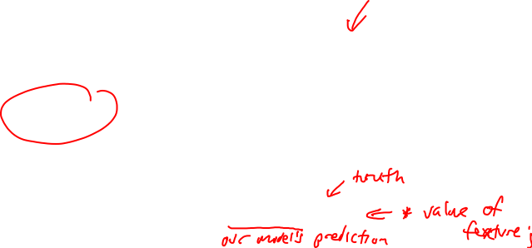
The Gradient
To update θ, we need a definition for the gradient ∇L( f (x; θ ), y).
For logistic regression the cross-entropy loss function is:
The derivative of this function for one observation vector x for a single weight w_{j} is
The gradient is a very intuitive value: the difference between the true y and our estimate for x, multiplied by the corresponding input value x_{j} .

Slide 37
The Gradient
The loss for a batch of data or an entire dataset is just the average loss over the m examples
The gradient for multiple data points is the sum of the indiviidual gradients:

Slide 38

Stochastic gradient descent algorithm
Notes:
Stochastic gradient descent is an online algorithm that minimizes the loss function by computing its gradient after each training example, and nudging θ in the right direction (the opposite direction of the gradient).
Stochastic gradient descent is called stochastic because it chooses a single ran- dom example at a time, moving the weights so as to improve performance on that single example. That can result in very choppy movements, so it’s also common to do minibatch gradient descent, which computes the gradient over batches of train- ing instances rather than a single instance.
The learning rate η is a parameter that must be adjusted. If it’s too high, the learner will take steps that are too large, overshooting the minimum of the loss func- tion. If it’s too low, the learner will take steps that are too small, and take too long to get to the minimum. It is most common to begin the learning rate at a higher value, and then slowly decrease it, so that it is a function of the iteration k of training; you will sometimes see the notation ηk to mean the value of the learning rate at iteration k.

Slide 39
Worked example

Slide 40
Neural Networks
The building block of a neural network is a single computational unit. A unit takes a set of real valued numbers as input, performs some computation.

